Slide 1


Pizza sales riport
Analysing pizza sales using sql queries

Slide 2
@mohammad-kaif1
Project Pizza Sales: An In-Depth Analysis :
Welcome to "Project Pizza Sales," a comprehensive data analysis project aimed at uncovering key insights from pizza sales data. In this project, we delve into various aspects of pizza sales, from basic metrics to advanced analytics, providing a clear and actionable overview of the business performance.
Objective :
The primary goal of this project is to analyze pizza sales data to answer critical business questions and provide actionable insights. This analysis will help stakeholders understand sales patterns, customer preferences, and revenue drivers.
Data Overview :
The dataset used for this analysis includes detailed information on pizza orders, such as order quantities, pizza types, sizes, prices, and order times. By leveraging this data, we aim to provide a holistic view of pizza sales and identify key trends and opportunities for improvement
Analysis Breakdown
The analysis is divided into three sections: Basic, Intermediate, and Advanced. Each section addresses specific questions to provide a thorough understanding of the pizza sales data.

Slide 3

I am going to answer these questions by sql queries.
Basic Analysis :
1.Retrieve the total number of orders placed.
2.Calculate the total revenue generated from pizza sales.
3.Identify the highest-priced pizza.
4.Identify the most common pizza size ordered.
5.List the top 5 most ordered pizza types along with their quantitie
Intermediate Analysis :
1.Join the necessary tables to find the total quantity of each pizza category ordered.
2.Determine the distribution of orders by hour of the day.
3.Join relevant tables to find the category-wise distribution of pizzas.
4.Group the orders by date and calculate the average number of pizzas ordered per day.
5.Determine the top 3 most ordered pizza types based on revenue.
Advance Analysis :
1.Calculate the percentage contribution of each pizza type to total revenue.
2.Analyze the cumulative revenue generated over time.
3.Determine the top 3 most ordered pizza types based on revenue for each pizza category.
@mohammad-kaif1

Slide 4
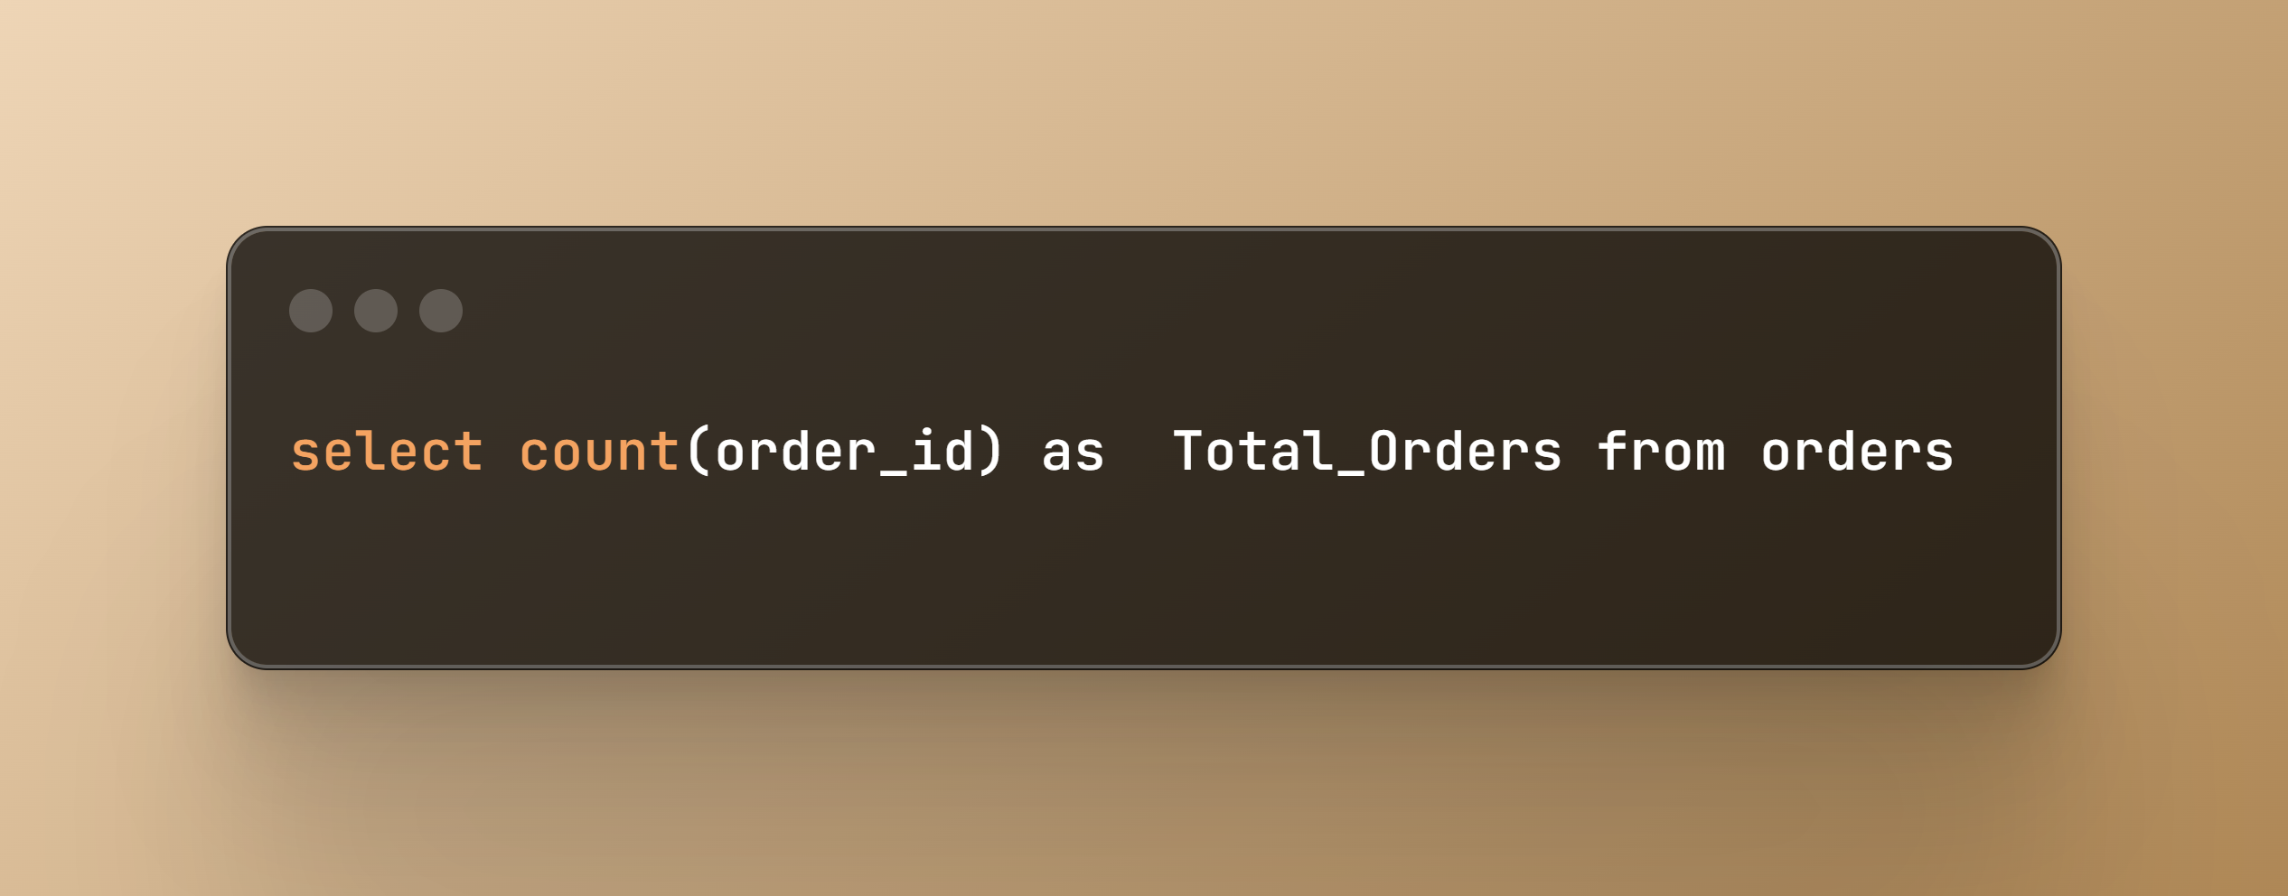
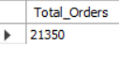
q1. Retrieve the total number of orders placed
@mohammad-kaif1

Slide 5
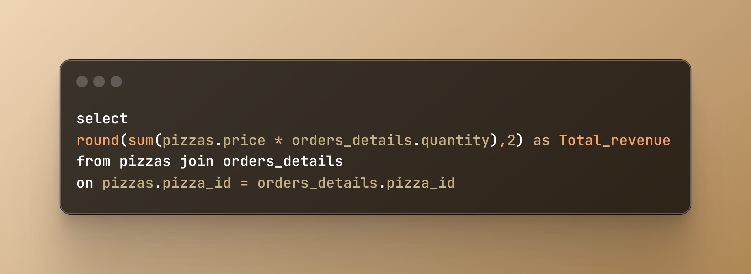
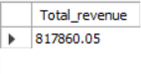
Q2. Calculate the total revenue generated from pizza sales.
@mohammad-kaif1

Slide 6
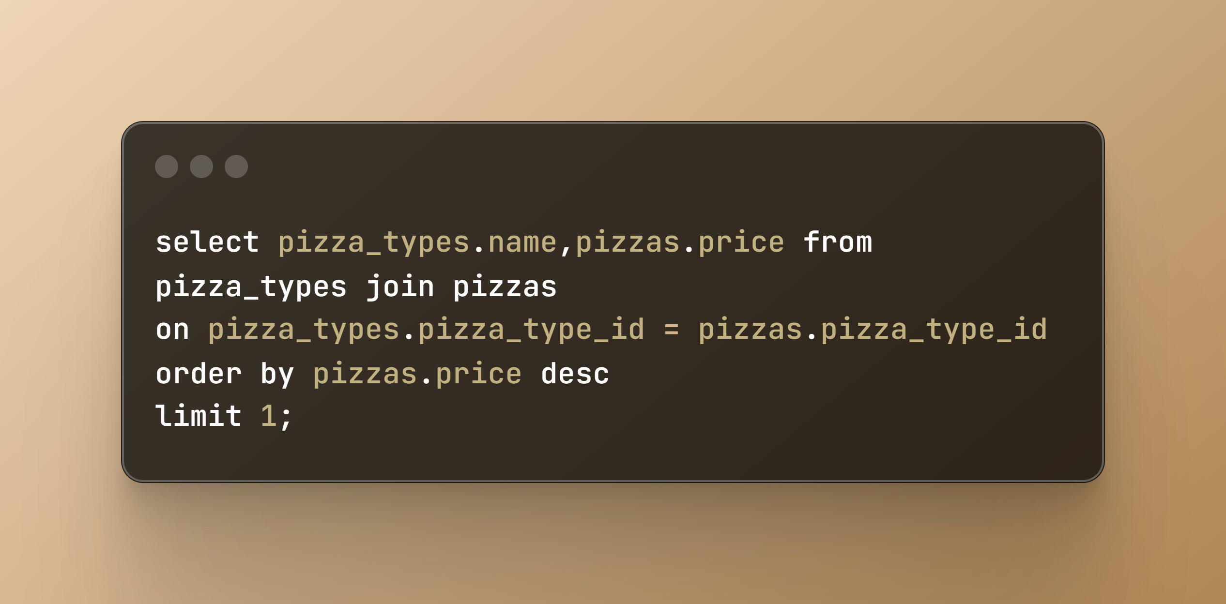
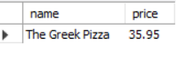
Q3. Identify the highest-priced pizza.
@mohammad-kaif1

Slide 7
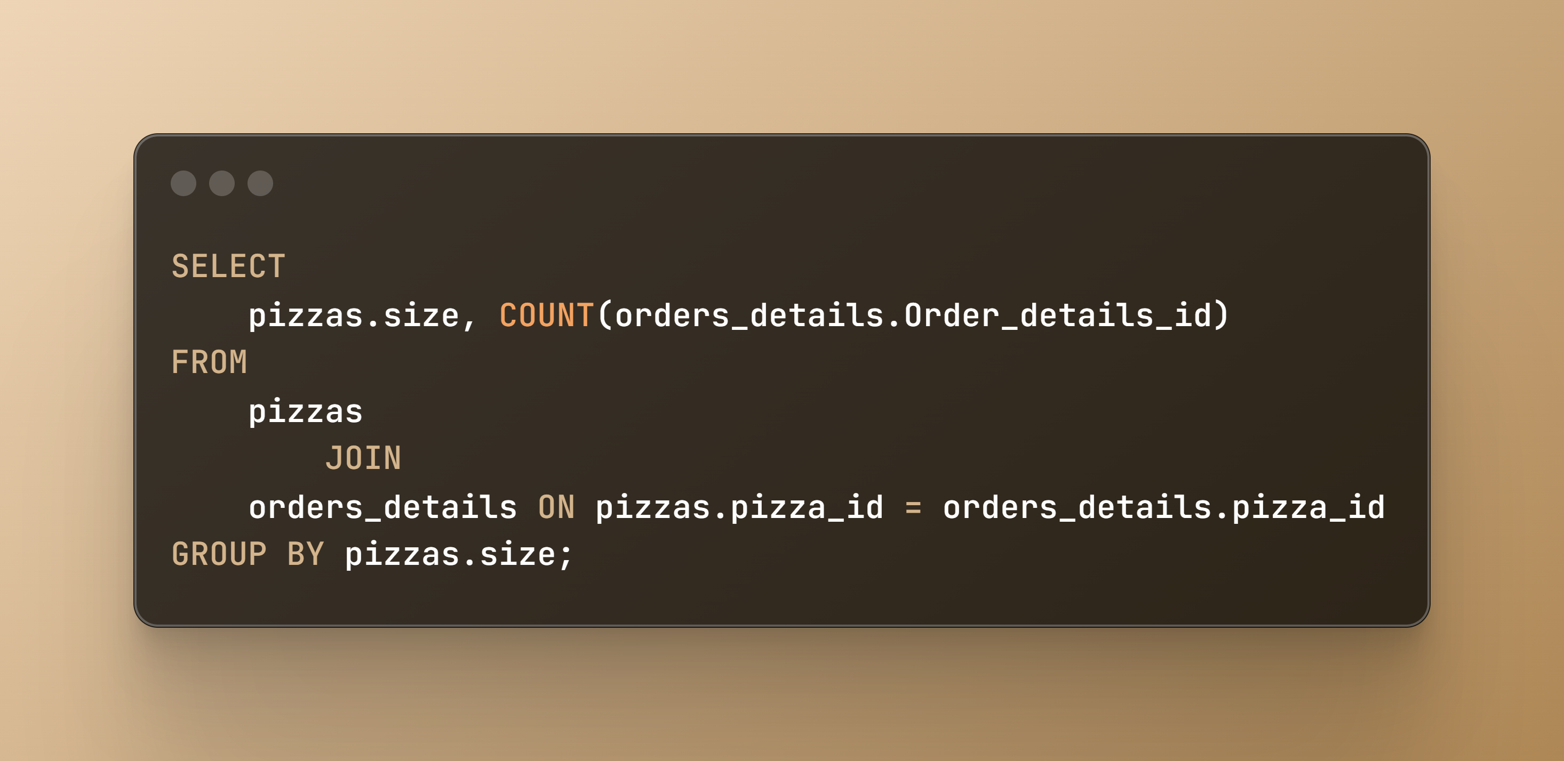
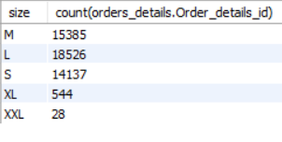
Q4. Identify the most commons pizza size ordered.
@mohammad-kaif1

Slide 8
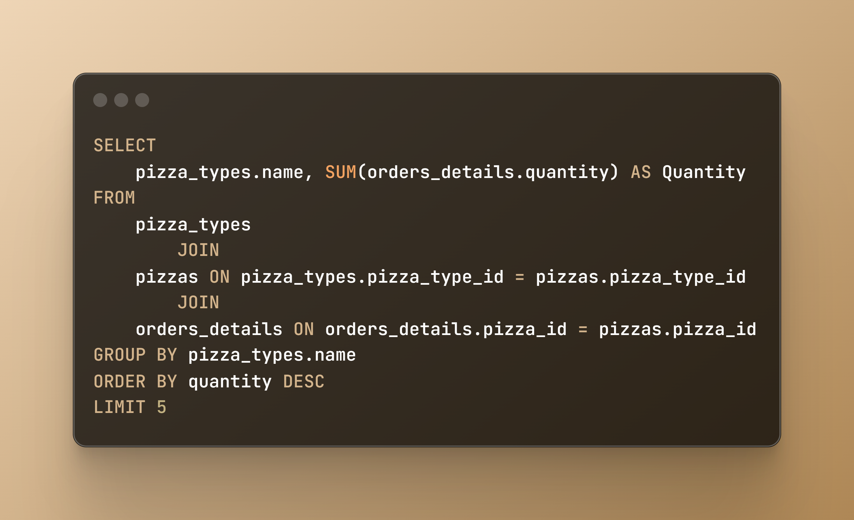
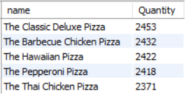
Q5. List the top 5 most ordered pizza types along with their quantities.

Slide 9
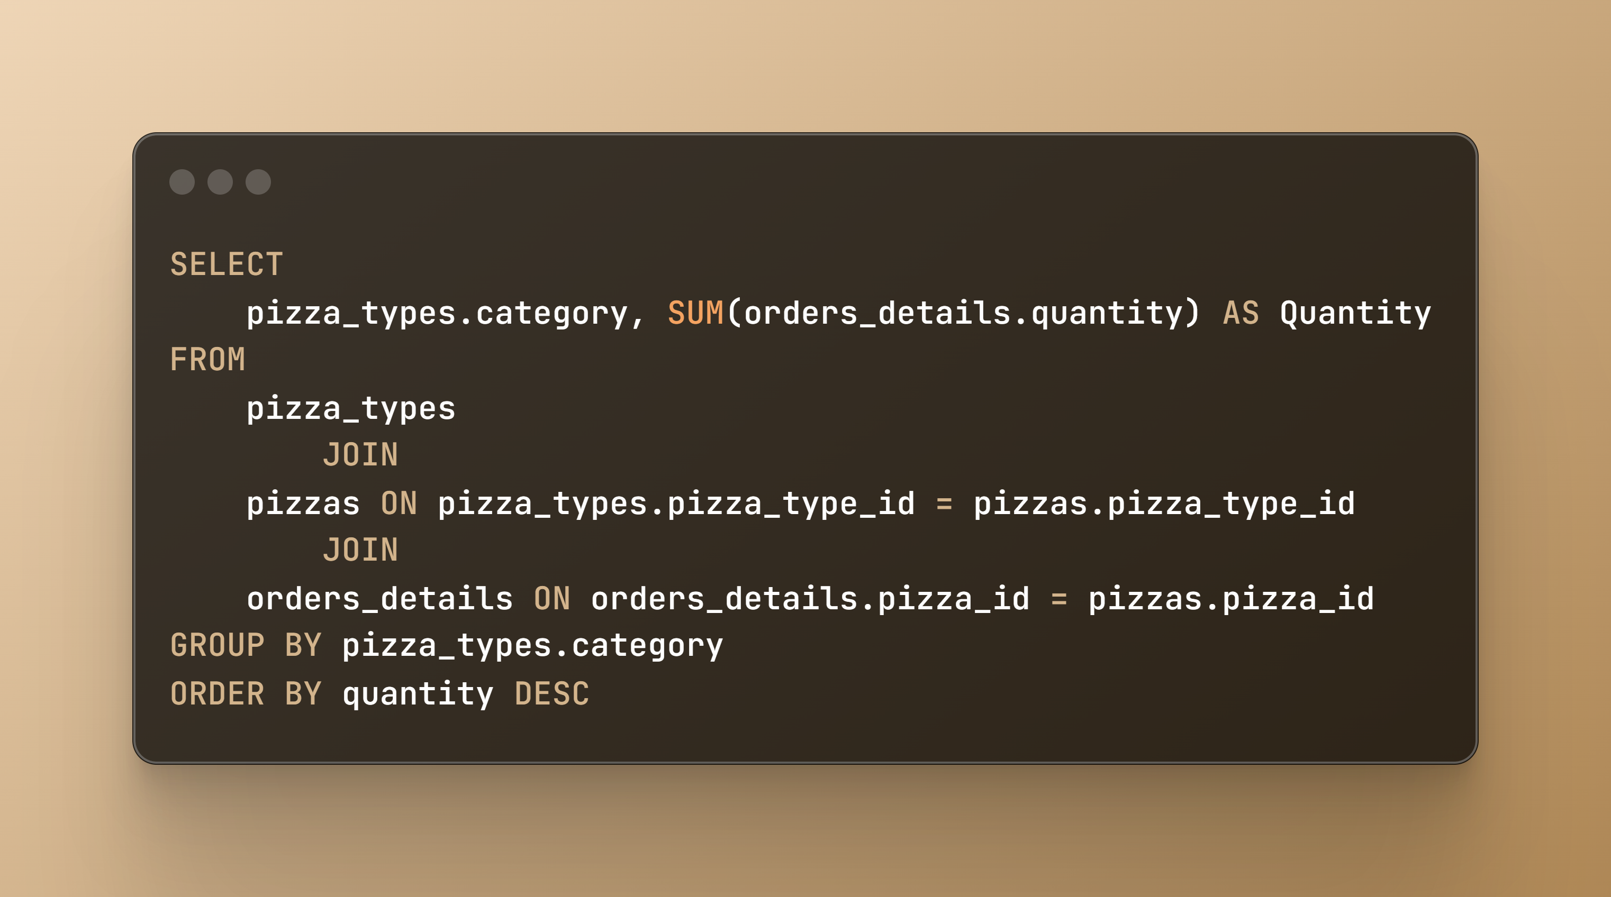
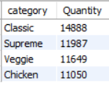
Q6. Join the necessary tables to find the total quantity of each pizza category ordered.
@mohammad-kaif1

Slide 10
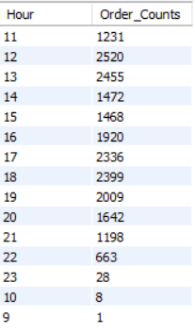
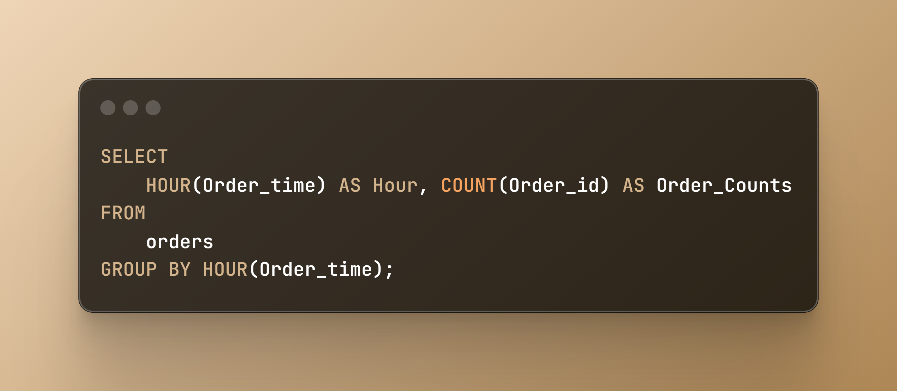
Q7.Determine the distribution of orders by hour of the day
@mohammad-kaif1

Slide 11
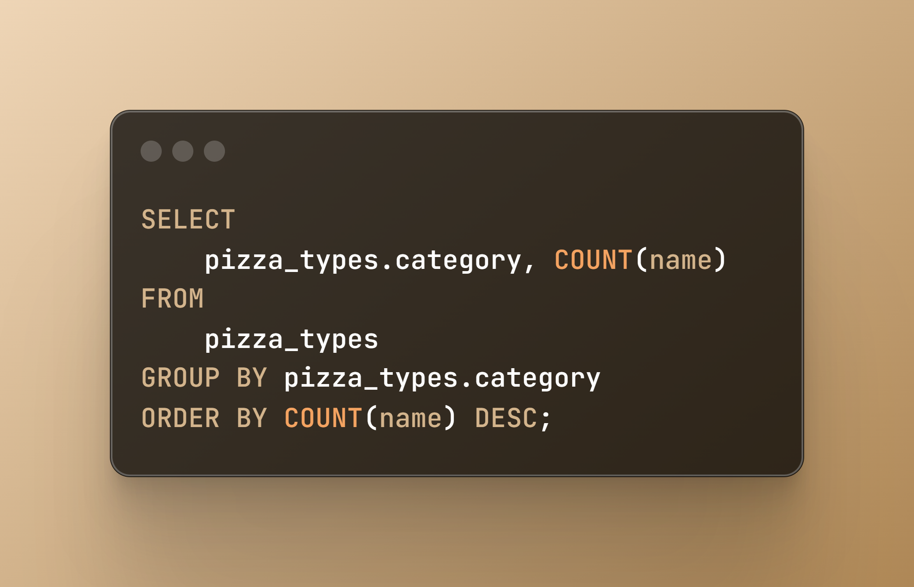
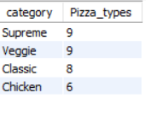
Q8. Join relevant tables to find the category-wise distribution of pizzas.
@mohammad-kaif1

Slide 12
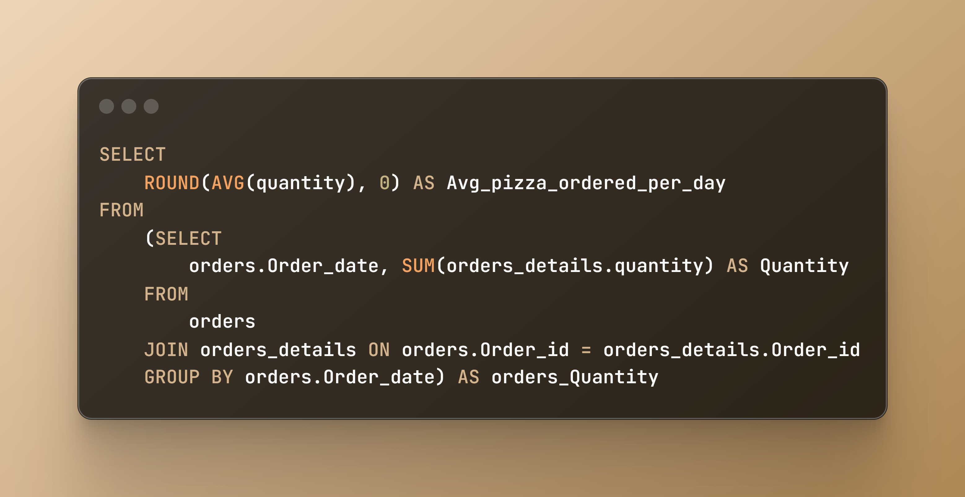
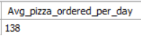
Q9. Group the orders by date and calculate the average number of pizzas ordered per day.
@mohammad-kaif1

Slide 13
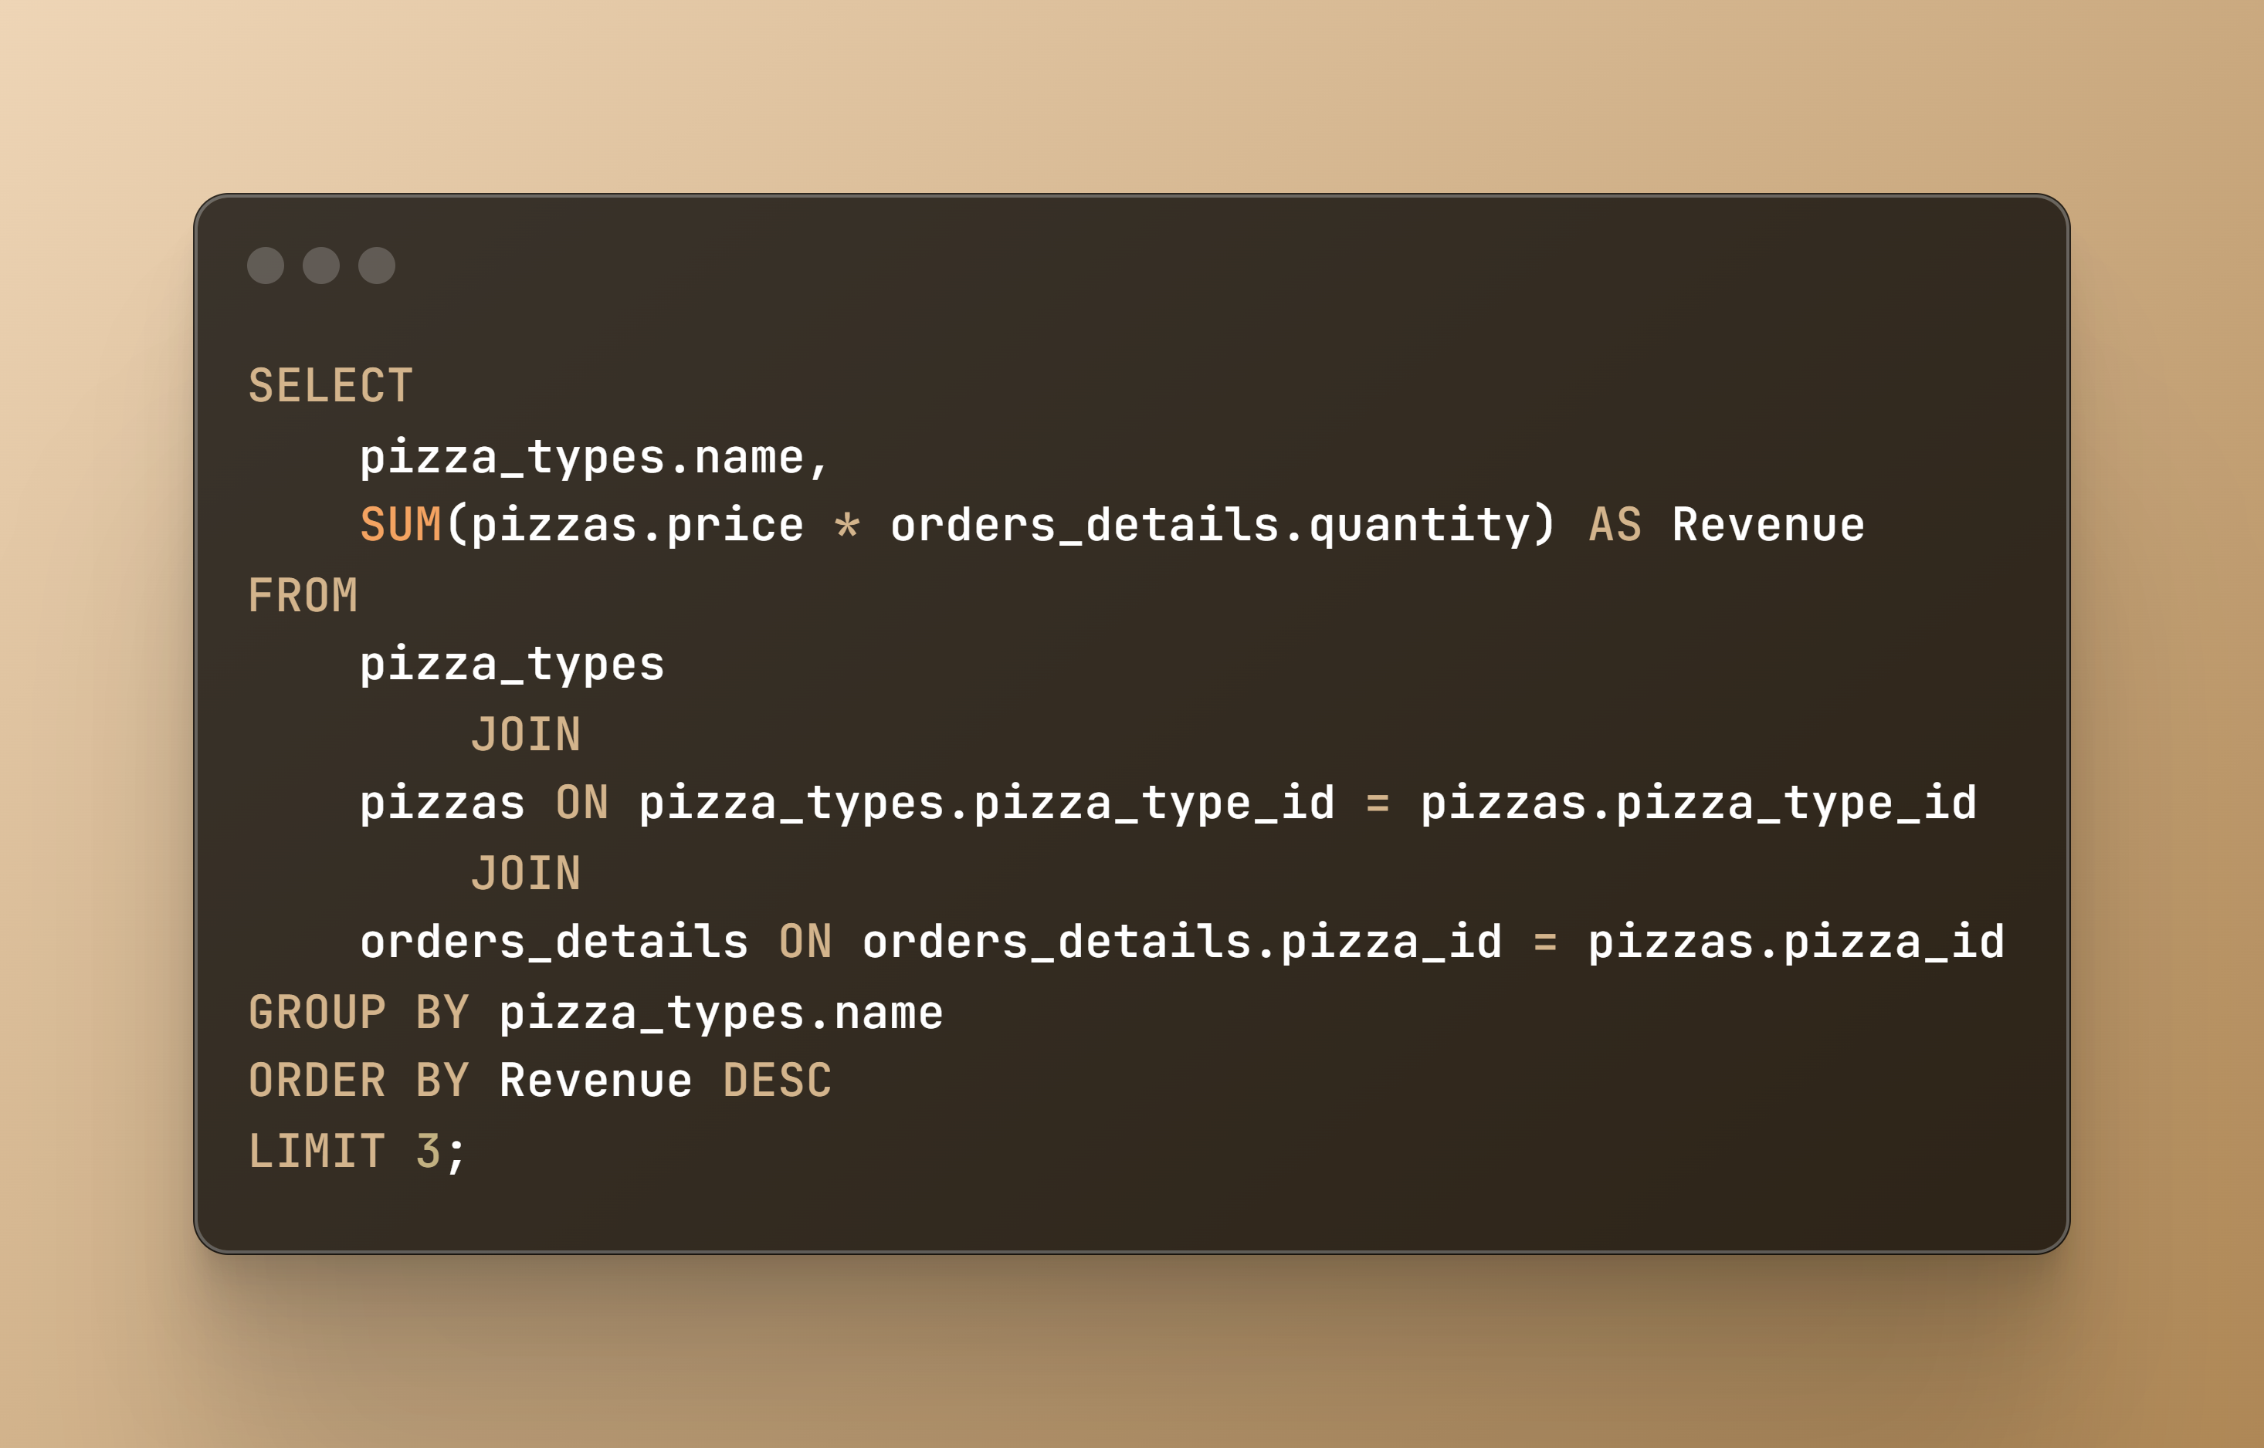
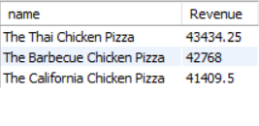
Q10. Determine the top 3 most ordered pizza types based on revenue.
@mohammad-kaif1

Slide 14
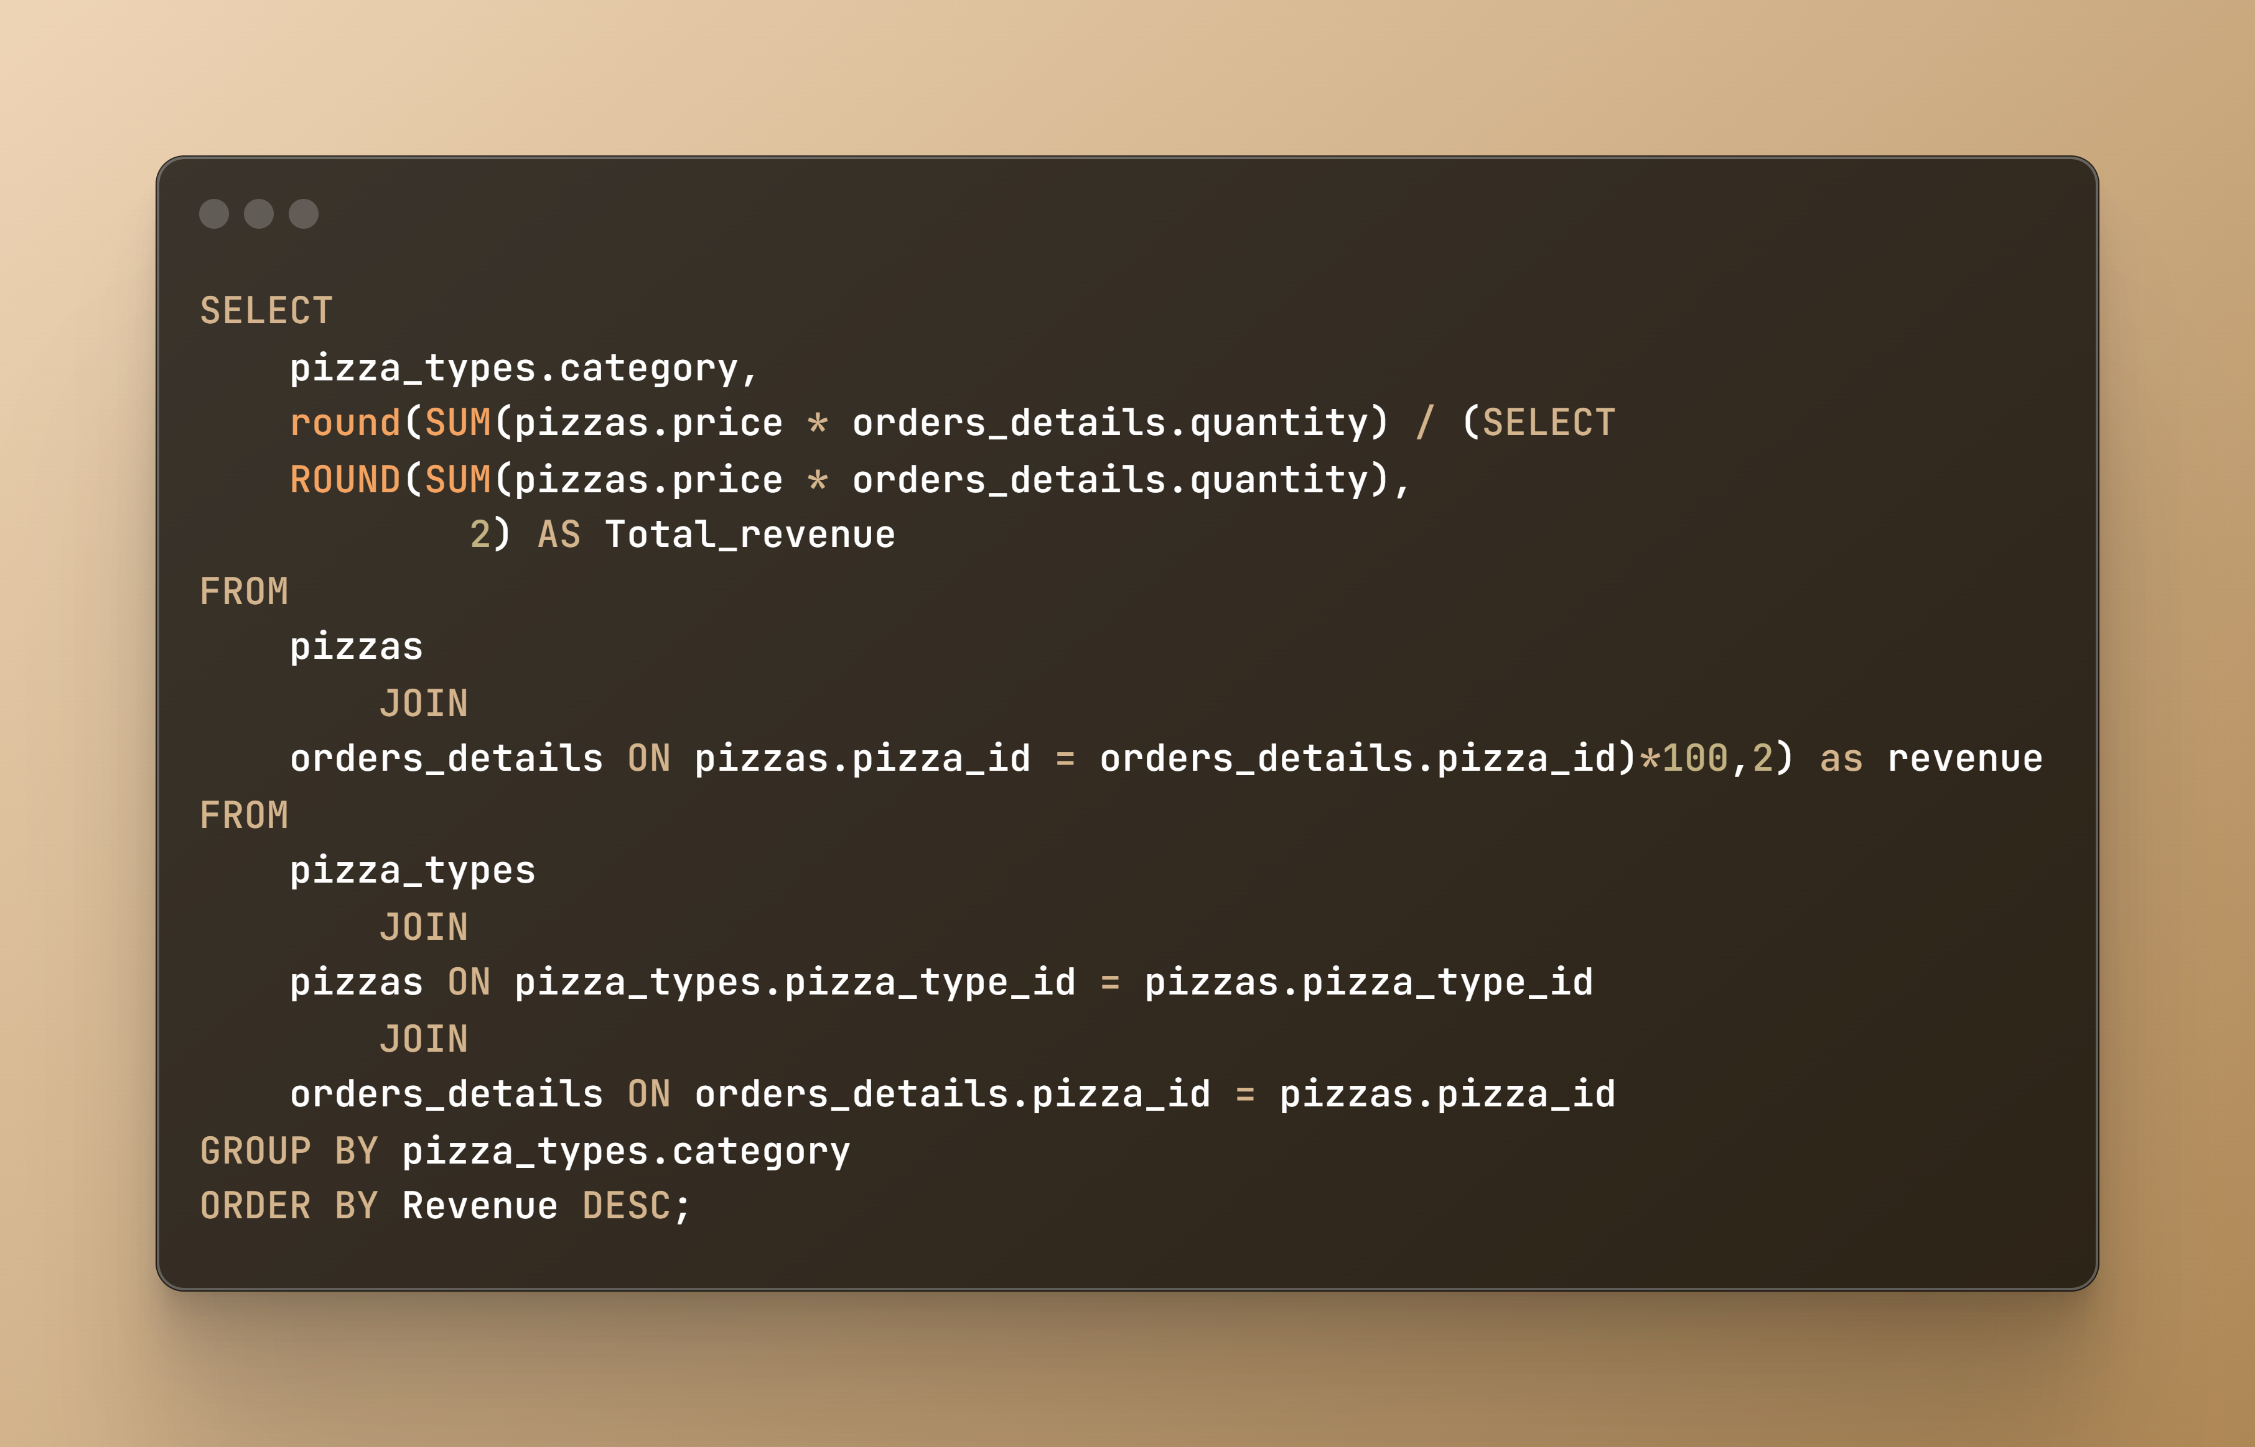
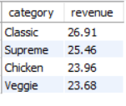
Q11. Calculate the percentage contribution of each pizza type to total revenue
@mohammad-kaif1

Slide 15
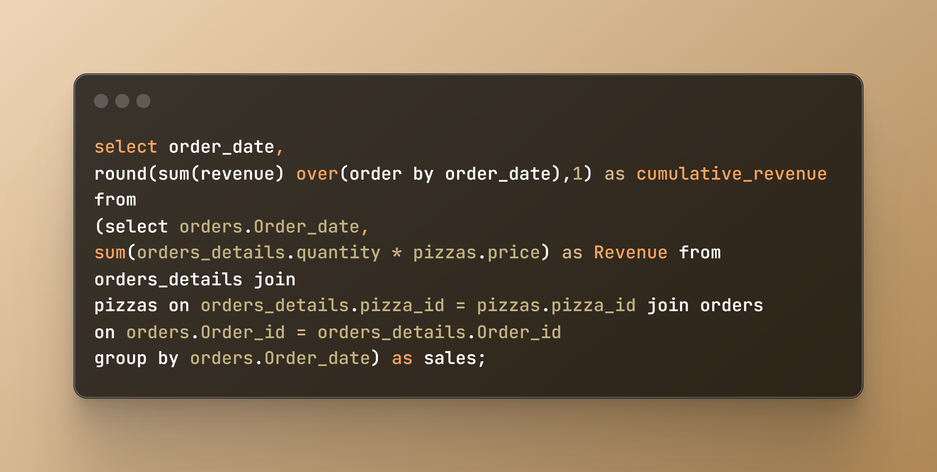
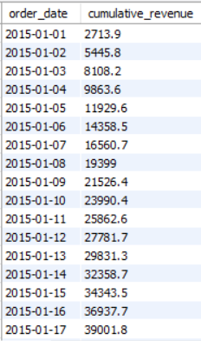
Q12. Analyze the cumulative revenue generated over time.
@mohammad-kaif1

Slide 16
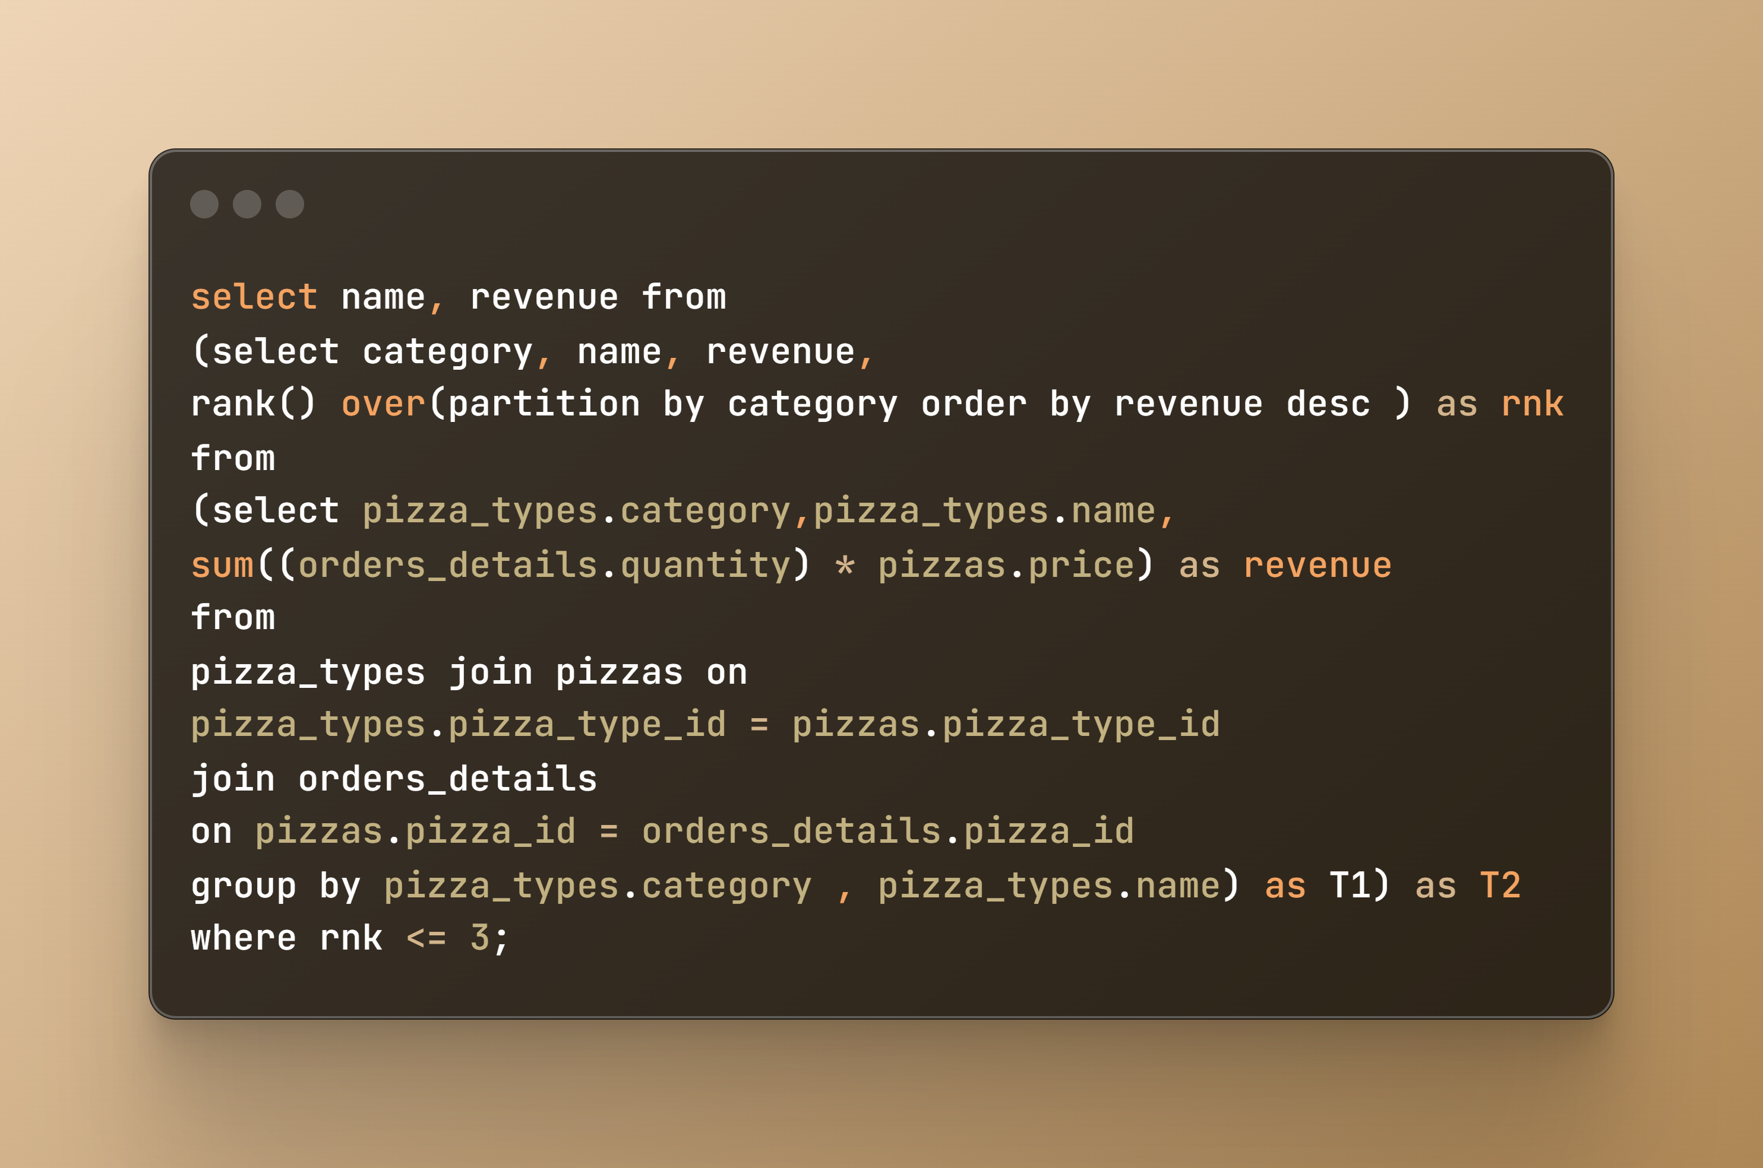
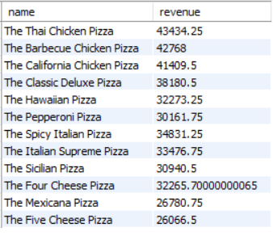
Q13. Determine the top 3 most ordered pizza types based on revenue for each pizza category.
@mohammad-kaif1

Slide 17

Conclusion
By conducting this in-depth analysis, "Project Pizza Sales" aims to provide valuable insights that can help optimize sales strategies, improve customer satisfaction, and drive business growth. Stay tuned for detailed findings and visualizations that highlight the key takeaways from this comprehensive study.
I Hope you enjoyed the pizza

